Slide 1
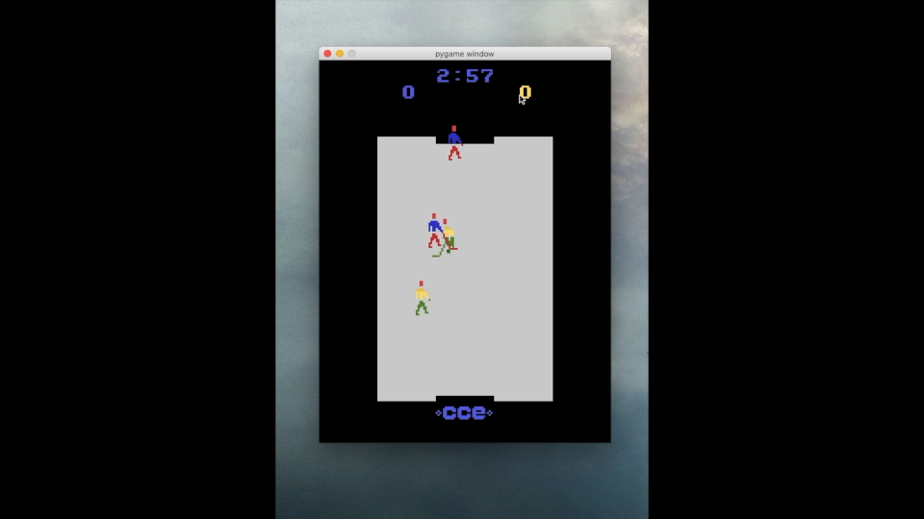
Teach AI to play Atari iceHockey game using gameplay videos
Presenter: Xu Yangyang [u6325688]
Supervisor: Dr. Penny Kyburz
COMP8755

Slide 2
Content
Problem statement & challenges
Background
Methods
Q&A

Slide 3
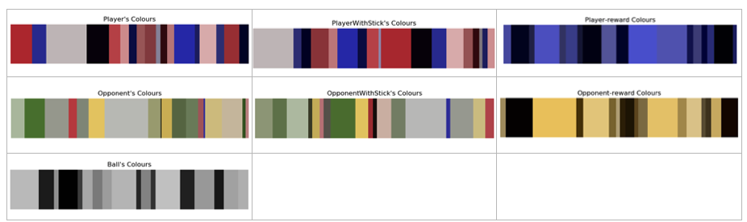
Problem statement
Use historical gameplay videos to teach AI play game (choose action).
Challenges
Videos have different resolutions and sizes.
Youtube gameplay videos do not have action records.

Slide 4

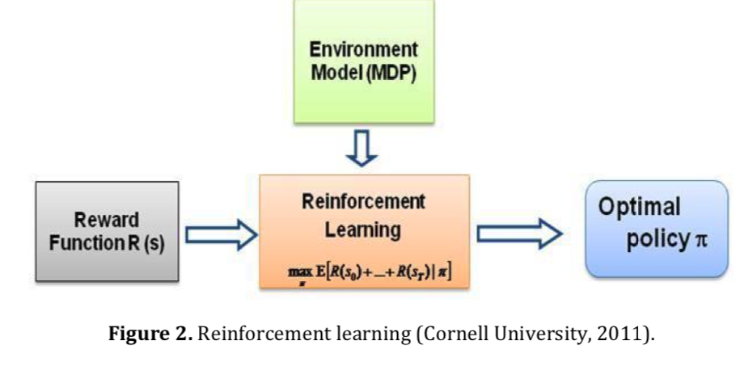
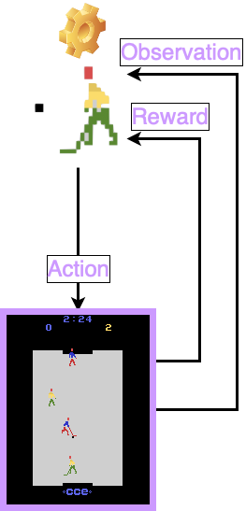

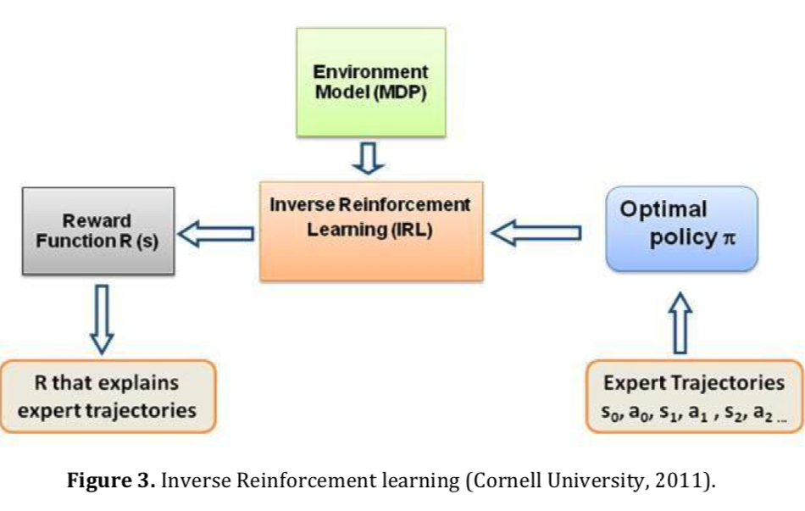
Background - Reinforcement Learning
Markov Decision Process (MDP):（State, Actions, Transition Probabilities, Reward）
Forward Reinforcement Learning
Pavaloiu, A., & Kose, U. (2017). Ethical artificial intelligence-an open question. arXiv preprint arXiv:1706.03021.
Inverse Reinforcement Learning
Pavaloiu, A., & Kose, U. (2017). Ethical artificial intelligence-an open question. arXiv preprint arXiv:1706.03021.

Slide 5

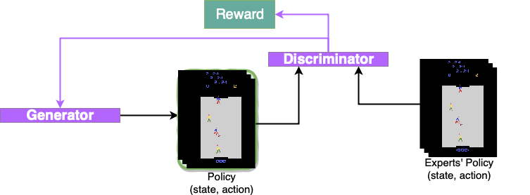
Method - GAIL
GAIL:（Generative Adversarial Imitation Learning)[1]
Pavaloiu, A., & Kose, U. (2017). Ethical artificial intelligence-an open question. arXiv preprint arXiv:1706.03021.

Slide 6
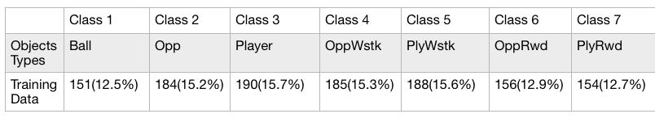
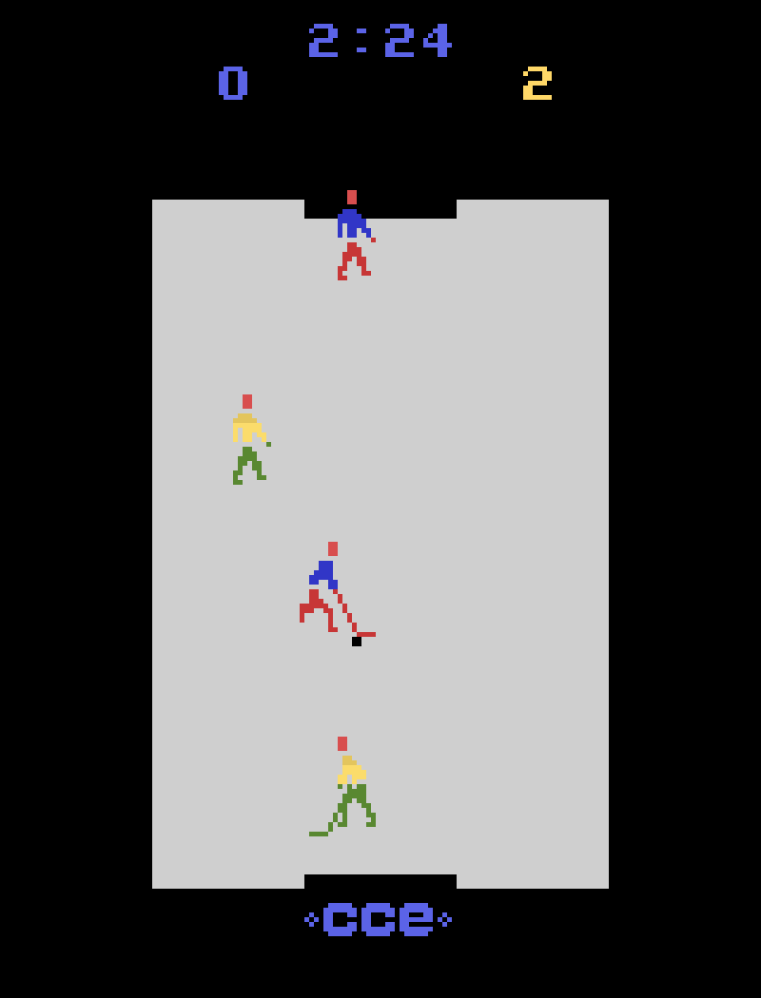
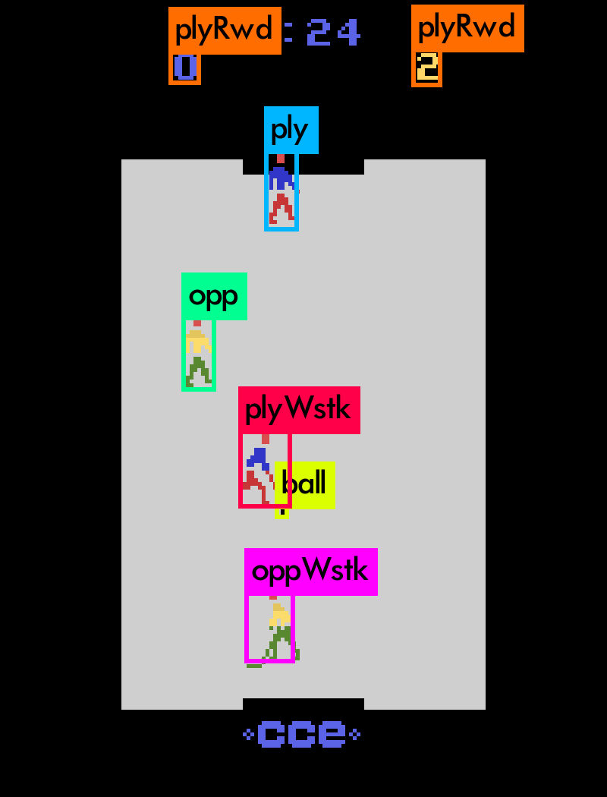
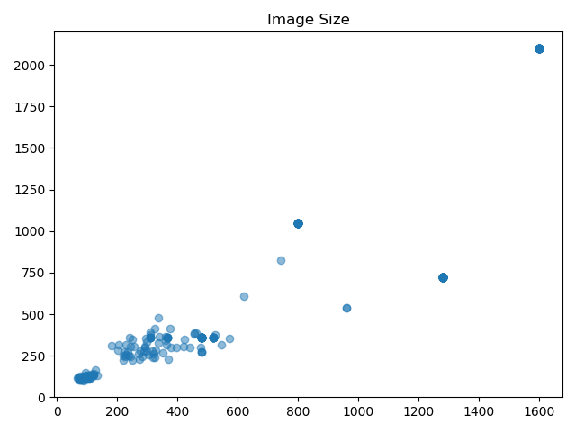
Method - State representation
Current Object Detection Method:
One-Stage
YOLO(You Only Look Once)[2]
Total: 264 training images
Framework: Darknet[3]

Slide 7
References
[1]Ho, J., & Ermon, S. (2016). Generative adversarial imitation learning. In Advances in neural information processing systems (pp. 4565-4573).
[2] Pavaloiu, A., & Kose, U. (2017). Ethical artificial intelligence-an open question. arXiv preprint arXiv:1706.03021.
[3]J. Redmon, "YOLO: Real-Time Object Detection", Pjreddie.com, 2019. [Online]. Available: https://pjreddie.com/darknet/yolo/. [Accessed: 08- Aug- 2019].

